Slide 1

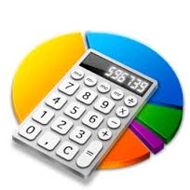

NUMERICAL COMPUTATION & EXPRESSION (part 2)
Topic 3

Slide 2

Objectives
To learn about data conversions
To learn complex arithmetic computation
To learn about accepting input from the user

Slide 3
Outline
Data Conversion
Complex arithmetic computation
Interactive Programs

Slide 4

Data Conversion
Sometimes it is convenient to convert data from one type to another.
For example, in a particular situation we may want to treat an integer as a floating point value.
These conversions do not change the type of a variable or the value that's stored in it – they only convert a value as part of a computation.

Slide 5
Data Conversion
Two types of data conversion:
Widening conversions are the safest because they tend to go from a small data type to a larger one (such as a short to an int)
Narrowing conversions can lose information because they tend to go from a large data type to a smaller one (such as an int to a short)

Slide 6
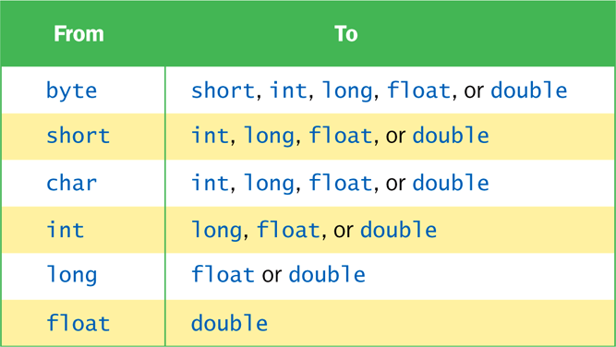
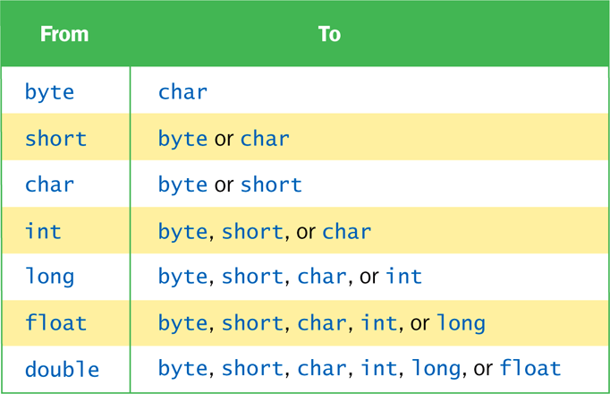
Data Conversion
Widening Conversions
Narrowing Conversions

Slide 7
Data Conversion
In Java, data conversions can occur in three ways:
Assignment conversion
Promotion
Casting

Slide 8
Assignment Conversion
Assignment conversion occurs when a value of one type is assigned to a variable of another.
Example:
int dollars = 20;
double money = dollars;
Only widening conversions can happen via assignment.
Note that the value or type of dollars did not change.

Slide 9
Promotion
Promotion happens automatically when operators in expressions convert their operands.
Examples:
int count = 12;
double sum = 490.27;
result = sum / count;
The value of count is converted to a floating-point value to perform the division calculation.

Slide 10
Casting
Casting is the most powerful, and dangerous, technique for conversion.
Both widening and narrowing conversions can be accomplished by explicitly casting a value.
To cast, the type is put in parentheses in front of the value being converted.
int total = 50;
float result = (float)total/6;
Without the cast, the fractional part of the answer would be lost.

Slide 11
Outline
Data Conversion
Complex arithmetic computation
Interactive Programs

Slide 12
The math class
Math class: contains methods like sqrt and pow
To compute x^{n}, you write Math.pow(x, n)
However, to compute x² it is significantly more efficient simply to compute x * x
To take the square root of a number, use the Math.sqrt; for example, Math.sqrt(x)

Slide 13

The math class
In Java,
can be represented as
(-b + Math.sqrt(b * b - 4 * a * c)) / (2 * a)

Slide 14
Mathematical Methods in Java
Math.sqrt(x) | square root
Math.pow(x, y) | power x^{y}
Math.exp(x) | e^{x}
Math.log(x) | natural log
Math.sin(x), Math.cos(x), Math.tan(x) | sine, cosine, tangent (x in radian)
Math.round(x) | closest integer to x
Math.min(x, y), Math.max(x, y) | minimum, maximum

Slide 15
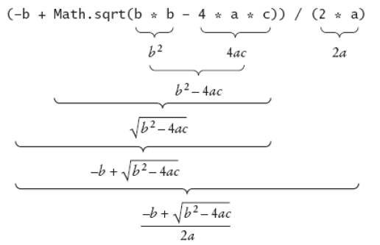
Analyzing an Expression

Slide 16
Outline
Data Conversion
Complex arithmetic computation
Interactive Programs

Slide 17


Interactive Program
CUST A
RM 10.50 +
RM 12.00 = RM22.50
CUST B
RM 10.00 +
RM 12.00 +
RM 30.00 =
RM 52.00

Slide 18
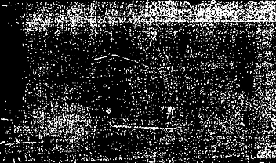

Demo Interactive Program in JGRASP

Slide 19
Classes in JAVA
String Tokenizer
Class
_______
Scanner Class
_______
_______
…
Class
_______
_______
Import
CalculateRect Class
_______
_______
JAVA.util class library
CalculatePrice Class
_______
_______
Classes created by JAVA users

Slide 20
How to Create Interactive Programs?
Import Scanner class:
import java.util.Scanner;
Create Scanner object:
Scanner scan = new Scanner (System.in);
Scanner read = new Scanner (System.in);
Once created, the Scanner object can be used to invoke various input methods, such as:
answer = scan. nextLine();
answer = read.nextLine();

Slide 21
Interactive Programs
Programs generally need input on which to operate.
The Scanner class provides convenient methods for reading input values of various types.
A Scanner object can be set up to read input from various sources, including the user typing values on the keyboard.
Keyboard input is represented by the System.in object.

Slide 22
Reading Input
The following line creates a Scanner object that reads from the keyboard:
Scanner scan = new Scanner (System.in);
The new operator creates the Scanner object
Once created, the Scanner object can be used to invoke various input methods, such as:
answer = scan.nextLine();

Slide 23
Reading Input
The Scanner class is part of the java.util class library, and must be imported into a program to be used
The nextLine method reads all of the input until the end of the line is found
See Echo.java

Slide 24
Methods for Scanner
Methods | Descriptions
nextByte() | Reads an integer of the byte type
nextShort() | Reads an integer of the short type
nextInt() | Reads an integer of the integer type
nextLong() | Reads an integer of the long type
nextFloat() | Reads a number of the float type
nextDouble() | Reads a number of the double type
next() | Reads a string that ends before whitespace character
nextLine() | Reads a line of text

Slide 25
Design Of Interactive Program: Pseudocode & Flow Chart
Start
Input message
Print "You entered: \"" + message + "\“”
End

Slide 26
//********************************************************************
// Echo.java Author: Lewis/Loftus
//
// Demonstrates the use of the nextLine method of the Scanner class
// to read a string from the user.
//********************************************************************
import java.util.Scanner;
public class Echo
{
//-----------------------------------------------------------------
// Reads a character string from the user and prints it.
//-----------------------------------------------------------------
public static void main (String[] args)
{
String message;
Scanner scan = new Scanner (System.in);
System.out.println ("Enter a line of text:");
message = scan.nextLine();
System.out.println ("You entered: \"" + message + "\"");
}
}

Slide 27
Sample Run
Enter a line of text:
I am enjoying myself with JAVA
You entered: "I am enjoying myself with JAVA"

Slide 28
Design Of Interactive Program: Pseudocode & Flow Chart
Start
Input miles, gallons
Calculate mpg = miles / gallons
Print “Miles per gallon” +mpg
End

Slide 29
//********************************************************************
// GasMileage.java Author: Lewis/Loftus
//
// Demonstrates the use of the Scanner class to read numeric data.
//********************************************************************
import java.util.Scanner;
public class GasMileage
{
//-----------------------------------------------------------------
// Calculates fuel efficiency based on values entered by the
// user.
//-----------------------------------------------------------------
public static void main (String[] args)
{
int miles;
double gallons, mpg;
Scanner scan = new Scanner (System.in);
continue

Slide 30
continue
System.out.print ("Enter the number of miles: ");
miles = scan.nextInt();
System.out.print ("Enter the gallons of fuel used: ");
gallons = scan.nextDouble();
mpg = miles / gallons;
System.out.println ("Miles Per Gallon: " + mpg);
}
}
Sample Run
Enter the number of miles: 328
Enter the gallons of fuel used: 11.2
Miles Per Gallon: 29.28571428571429

Slide 31

TODAY’S TAKE AWAY
Data conversions
- Widening & narrowing conversions
- Assignment, promotion, casting
Complex arithmetic computation
- Math class
Accepting input from the user
- Importing Scanner class
- Creating Scanner object
- Reading input from keyboard using Scanner methods,
e.g.: nextInt(), nextLine().

